Slide 1
A Study in NoSQL & Distributed Database Systems
John Hawkins

Slide 2
Topics to Cover
What is NoSQL (and why use it)
Types of NoSQL
OrientDB
Distributed Databases

Slide 3
NoSQL Movement: What is it all about?
NoSQL is term for a movement in database design away from traditional relational database models.
With the emergence of big data and cloud computing, traditional databases and schema driven data design is too constraining.

Slide 4
Reasons for NoSQL Databases
Schema-less data storage
Quick data storage and traversal
Easier to program
Better performance
Easily distributed

Slide 5
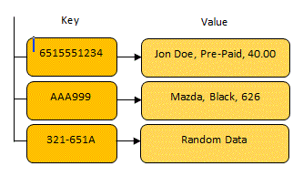
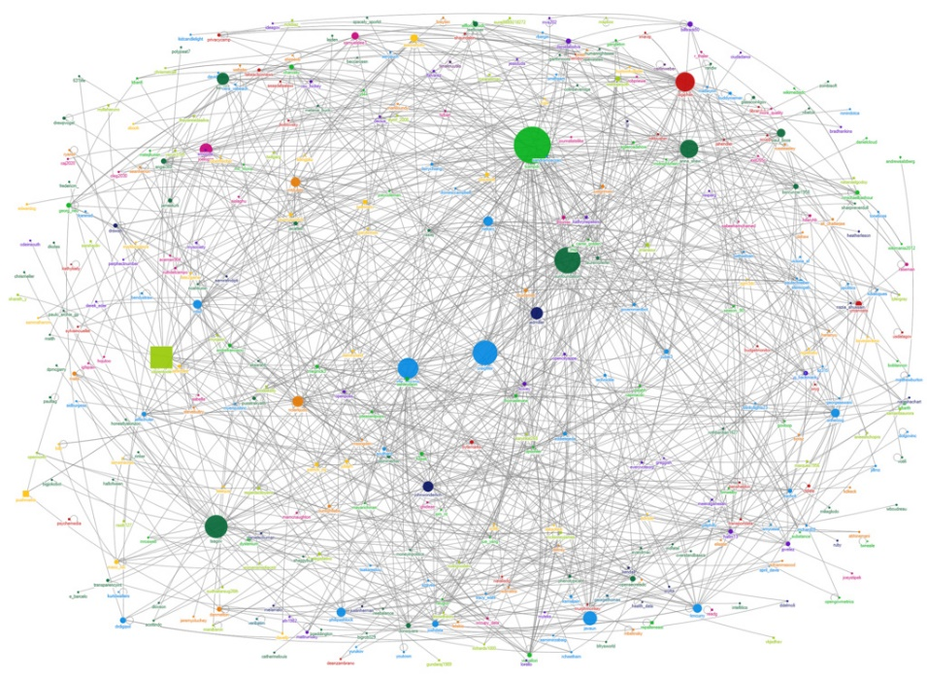
Three Popular NoSQL Designs
Key / Value Store
Document Database
Graph Database

Slide 6
Key / Value Store
Key / Value store databases allow for values to be associated with and looked up by a key.
Keys can be associated with more than one value.
Data can be stored in the native data type of a particular programming language.

Slide 7
Document Database
Document databases store information in documents such as JSON or XML.
Document format implies the relationship between data points in the document.
Most documents create hierarchies of data inside themselves.

Slide 8
Graph Database
Graph databases store all of their information in nodes (vertices) and edges.
Graph traversal is how you “query” the database.
Relationship information about nodes is stored in the edges.

Slide 9
OrientDB
Combined graph database and document database design.
Uses JSON documents to store information in nodes and edges of the graph.
Uses an HTTP REST API to access / edit the database.

Slide 10
OrientDB
Runs on the Java Virtual Machine, which allows it to be run on almost any machine in the modern world.
Has APIs written in C / C++, Ruby, PHP, and Java
Because of its use of HTTP, can be easily distributed across multiple machines.

Slide 11
Distributed Databases
Often times, as databases grow larger, it is necessary to expand the hardware powering them
Distributed databases take advantage of cheaper hardware by having multiple computers work together rather than building one large machine.

Slide 12
Replication
Replication copies the entire database across all nodes in the distributed system.

Slide 13
Sharding
Sharding divides the data inside the database and partitions pieces of it to different nodes.
Databases can be sharded horizontally (by rows) or vertically (by columns).

Slide 14
Pros / Cons of Each
 | Sharding | Replication
Pros | Fast data writing / reading. Low memory overhead. | Fast data reading. High data reliability.
Cons | Potential data loss | High network overhead. High memory overhead.

Slide 15



NoSQL Distributed Databases
Nearly all NoSQL database systems natively support distributed database designs . This is part of what makes NoSQL databases so appealing.

Slide 16
In Summary
NoSQL is a movement away from relational databases
NoSQL databases allow programmers to easily traverse and manipulate data.
Databases like OrientDB are readily available and free to use.
Distributed databases take full advantage of a cluster of less expensive hardware.

Slide 17
Any Questions?

Slide 18
References
http://www.mongodb.com/nosql-explained
http://www.couchbase.com/why-nosql/nosql-database
https://github.com/orientechnologies/orientdb/wiki/Tutorial%3A-Introduction-to-the-NoSQL-world
http://en.wikipedia.org/wiki/NoSQL
https://github.com/orientechnologies/orientdb/wiki/Distributed-Architecture#how-does-it-work
http://en.wikipedia.org/wiki/Shard_(database_architecture)
https://github.com/orientechnologies/orientdb/wiki/Tutorial%3A-Installation
https://github.com/orientechnologies/orientdb/wiki/Tutorial%3A-setup-a-distributed-database

